Slide 1
Review & exercises
Essential Calculus

Slide 2
Chapter 1. functions and limits
Determine whether a rule is a function or not.
Find domain, range of a function, e.g, f(x)=x/(x²-1)
Determine whether a function, e.g, f(x)=x.cos³x is odd/even or not.
Find the limit lim_{(x0-)}(1/(2+e^{1/x})), if it exists.
Find the limit lim_{(x 0)}((1-cosx)/x²)
Find lim_{(x 1)}((x³-1)/(x²-1))
Find all asymptotes of f(x)=(x²-3x+2)/(x²-1)
Find the limit lim_{(x )}((x+2)/(x+1))^{2x}
Find the limit lim_{(x )}((x²+x+3)^{1/2}-x).

Slide 3
Let h = f□g. If f(x) = x³ and g(t)= 2t + 7, then what is h(k)?
A. h(k) = (2k + 7)³
B. h(k) = 2k³ + 7
C. h(k) = k³(2k + 7)
D. None of the others
f□g(x) = f(g(x))

Slide 4
Find
A. 1
B. 2
C. 1/2
D.None of the others

Slide 5
Which of the following are odd functions?
A. f(x)= x³+x²
B. f(x)= sin2x
C. f(x)=sin(x+2)
D. f(x)= x³ – x+1
Odd: f(-x)=-f(x) for all x in domain
Even: f(-x)=f(x) for all x in domain

Slide 6

Find the domain of the function $f\left(x\right)=\frac{5}{2−cosx}$
A. (-∞, +∞)
B. (-π, π)
C. [-π, π]
None of the others

Slide 7
Suppose that the graph of f is given. Describe how the graph of the function y = f(x+3) – 5 can be obtained from the graph of y = f(x).
A. Shift the graph 3 units to the right and 5 units down.
B. Shift the graph 5 units to the right and 3 units down.
C. Shift the graph 5 units to the left and 3 units down.
D. Shift the graph 3 units to the left and 5 units down.

Slide 8

Consider the function $f\left(x\right)=\left\{\begin{aligned}2x+5 if x>3 \\ x2−2 if x≤1 \\ \frac{1}{x} if 1<x<3\end{aligned}\right.$
Find the domain of the function
R
R – {1, 3}
R – {x | 1 < x < 3}
None of the others

Slide 9

Consider the function $f\left(x\right)=\left\{\begin{aligned}2x+c if x>3 \\ x2−(b+c) if x≤1 \\ −3+b if 1<x<3\end{aligned}\right.$
Find all values of c and b so that the function is continuous for all x in domain.
a = 2, b = -1
a = -2, b = 1
a = -6, b = -3
a = -3, b = 2
None of the others

Slide 10
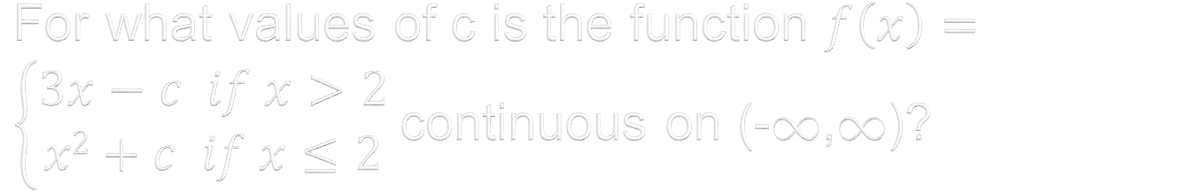
For what values of c is the function $f\left(x\right)=\left\{\begin{aligned}3x−c if x>2 \\ x2+c if x≤2\end{aligned}\right.$ continuous on (-,)?
c = 2
c =-3
c = 1
c = -5
None of the others

Slide 11
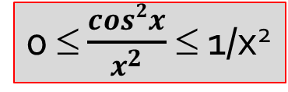

Find the limit $\lim_{x→∞}{\frac{cos2x}{x^{2}}}$
0
Infinity
1
½
None of the others
0 ≤ $\frac{cos2x}{x^{2}}$ ≤ 1/x²

Slide 12
Chapter 2. derivatives
Find the average velocity of a partical whose position function is s(t)=t²-2t, over [3,3.01].
Find the slope of the tangent line and normal line to the curve y=lnx at the point (1,0)
Find the derivative f’(0) where f(x)={(x²sinx, if x0), (0, if x=0)}
Find dx/dt, if dy/dt =2 at x=1, where x²(t)+y(t)+y³(t)=1.
Find the derivative of the function y(x) where x³+cosy-y=25
Find F’(1) where F= f□g,i.e, F(x)=f(g(x)), f(u)=1/u, g(x)=x²
A triangle with two sides 3 and 5. The angle between these side is increasing at a rate 0.5 rad/s. How fast (i.e, the rate of change) is the area of the triangle increasing when the angle is /4 radians?
Find the linearization of the function y=x^{1/3} at a=1 and use it to estimate (0.96)^{1/3}
One side of a square was measured and found to be 20cm with possible error is 0.5 cm. What is the maximum error in using this value to compute the area of the square? (use differential to approximate)

Slide 13
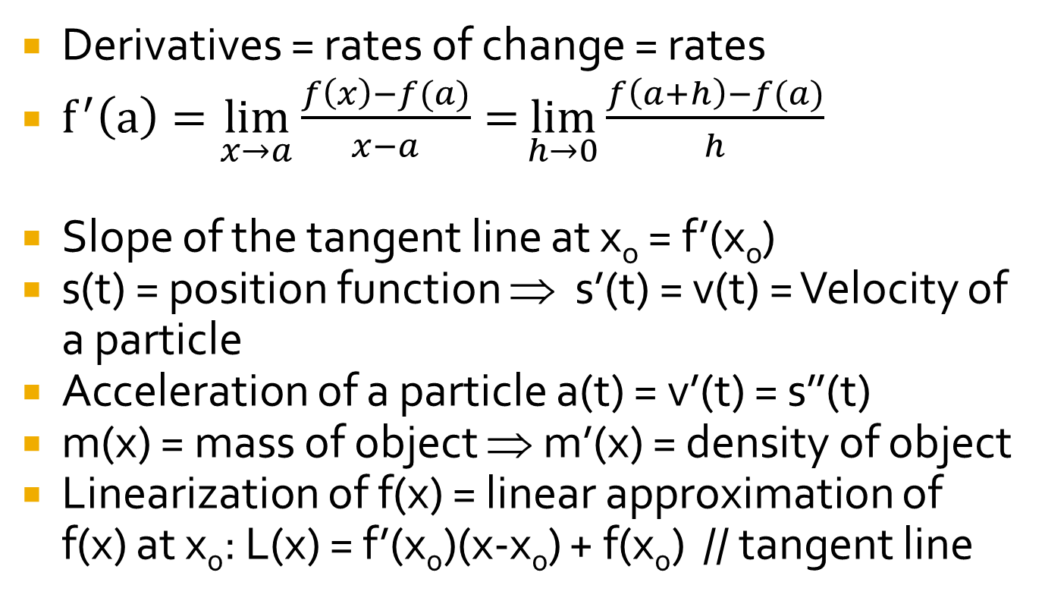
derivatives
Derivatives = rates of change = rates
$f^{′}\left(a\right)=\lim_{x→a}{\frac{f\left(x\right)−f(a)}{x−a}=}\lim_{h→0}{\frac{f\left(a+h\right)−f(a)}{h}}$
Slope of the tangent line at x_{o} = f’(x_{o})
s(t) = position function ⇒ s’(t) = v(t) = Velocity of a particle
Acceleration of a particle a(t) = v’(t) = s’’(t)
m(x) = mass of object ⇒ m’(x) = density of object
Linearization of f(x) = linear approximation of f(x) at x₀: L(x) = f’(x₀)(x-x₀) + f(x₀) // tangent line

Slide 14
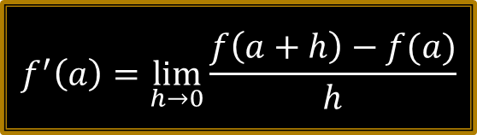
Find
A. -1
B. 1
C. 0
D. None of the others
$$f^{′}\left(a\right)=\lim_{h→0}{\frac{f\left(a+h\right)−f(a)}{h}}$$

Slide 15
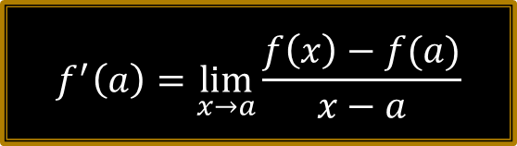

Find $\lim_{x→1}{\frac{x2016−1}{x−1}}$
A. 2016
B. 2015
C. 2017
D. 1/2016
E. None of the others
$$f^{′}\left(a\right)=\lim_{x→a}{\frac{f\left(x\right)−f(a)}{x−a}}$$

Slide 16
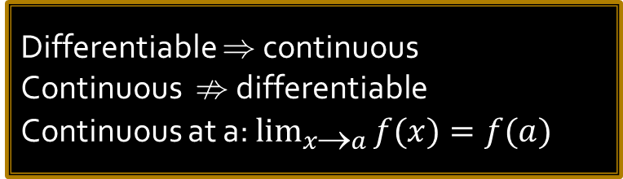
Choose the true statements.
A. If f is continuous at a then f is differentiable at a.
B. If f’(r) exists then the limit of f as x approaches r is f(r).
C. f is differential at a if and only if f is continuous at a.
D. None of the others
Differentiable  continuous
Continuous  differentiable
Continuous at a: $\lim_{x→a}{f(x)}=f(a)$

Slide 17
Suppose h(x)=f(g(x)) and f(-1)=3,g(0)=3,g’(0)= -2,f’(3)=2, f’(1)=-2. Find h’(0).
A. 2
B. -2
C. 4
D. 3
E. None of the others
The chain rule: (sin(x²))’ = cos(x²).2x
➔ In general, [g(f(x))]’= g’(f(x)).f’(x)

Slide 18
Let f(x)=g(ln(x²+1)). Find f’ in terms of g’.
A. f’(x)= g’(ln(x²+1)).2x
B. f’(x)=g’(ln(x²+1))
C. f’(x)=g’(x).2x
D. None of the others
The chain rule: [g(f(x))]’= g’(f(x)).f’(x)

Slide 19
Let x+y-2e^{y}=0. Find dy/dx by implicit differentiation.
A. dy/dx=2e^{y}-1
B. dy/dx=1/(e^{y}+1)
C. dy/dx=1/(e^{y}-1)
D. None of the others

Slide 20
If y = 1/(x+1) and dx/dt=2, find dy/dt when x=1.
A. 1
B. 2
C. 1/2
D. -1/2

Slide 21
Which of the following is the equation of the tangent line to the curve y= x² – x at the point (1,0) ?
A. y = x-2
B. y = x+1
C. y = -x-1
D. y = x-1
tangent line at (x_{o},f(x_{o})): y=f’(x_{o})(x-x_{o})+f(x_{o})
normal line  tangent line at (x_{o},f(x_{o}))

Slide 22
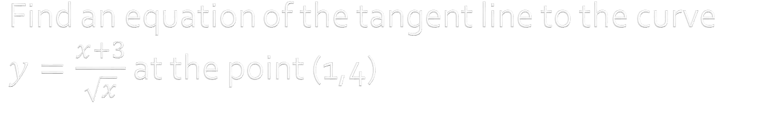
Find an equation of the tangent line to the curve $y=\frac{x+3}{\sqrt{x}}$ at the point (1,4)
y = 2x – 1
y = -x + 3
y = -x +5
y = x – 1
None of the others

Slide 23
The position function of a particle is given by s(t) = t³ – 3t² + 11 . Find its velocity after 3 seconds.
v(3) = 6
v(3) = 9
v(3) = -4
v(3) = 12
None of the others

Slide 24
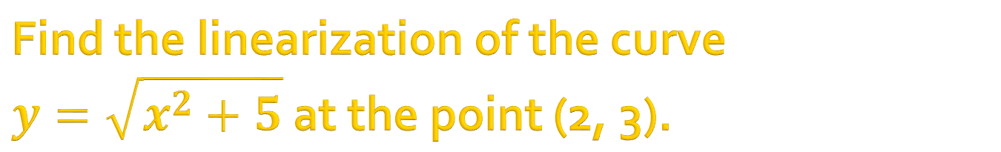
Find the linearization of the curve $y=\sqrt{x^{2}+5}$ at the point (2, 3).
L(x) = 2x/3 +1/3
L(x) = 2x/3 +5/3
L(x) = x/3 - 1/3
L(x) = x/3 - 5/3
None of the others
Linearization of f(x) = linear approximation of f(x) at x₀: L(x) = f’(x₀)(x-x₀) + f(x₀) // tangent line

Slide 25
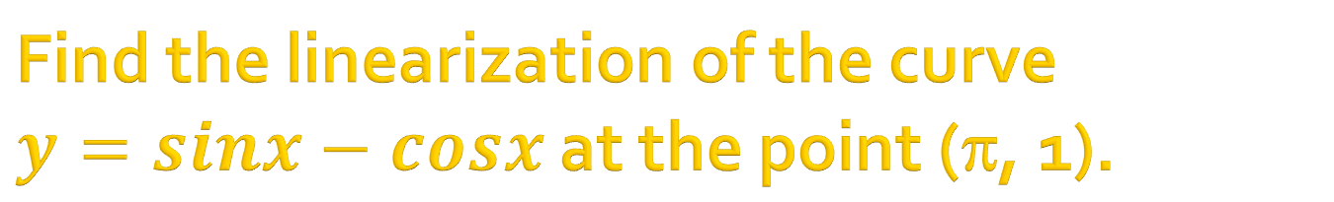
Find the linearization of the curve $y=sinx−cosx$ at the point (π, 1).
y = -x + 1
y = -x + π+1
y = x - π + 1
y = x - π - 1
None of the others

Slide 26
Chapter 3. applications of differentiation
Find the maximum and minimum values of functions.
Find the number c in the Rolle’s theorem for functions
Determine the statement is true or false :”There exists a function such that f(2)=-2, f(0)=1 and f’(x)>0 for all x”.
Suppose that f(1)=-2 and f’(x)7 for all x. How small can f(3) possibly be?
Find all inflection points of the function f(x)=cosx-3 on [0,4]
A box with open top and square base must have the volume 4000 cm³. Find the dimensions of the box that minimize the amount of metarial used.
Using Newton’s method to find the root of the equation x⁵-3=0. If x₁=1, find x₃, the third approximation to the root.
Find the maximum and minimum values of f(x)=x-x^{1/2} on [0,3]
For what values of the constants a and b is (1,6) a inflection point of the curve y=x³+ax²+bx+1?
Find the most general antiderivative of the function f(x)=e^{-x}-x⁻¹
Find f(x) if f’’(x)=sin3x, f’(0)=1, f(0)=0

Slide 27
Suppose f(2)=2 and 10≤f’(x) for all x. How small can f(6) possible be?
A. 42
B. 40
C. 20
D. 52
Mean value theorem:
c(a,b): f(b)-f(a)=(b-a).f’(c)
Rolle’s theorem:(with f(b)=f(a))
c(a,b): f’(c)=0

Slide 28
Use Newton’s Method with initial approximation x₁= 2 to find x₂, the second approximation to the root of the equation x³-3x-1=0.
A. -1.7
B. -1.8
C. -1.3
D. -1.5
x_{n+1}=x_{n} –f(x_{n})/f’(x_{n})
x₁x₂ x₃ …

Slide 29
A particle moves in the straight line and has acceleration given by a(t)=4t-3 (cm/s²). Its initial velocity is v(0)=3cm/s. Find its velocity after 5 seconds.
A. 28
B. 20
C. 17
D. None of the others
(s(t) = position function)’ = v(t)=velocity
(v(t) = velocity)’ = a(t)= acceleration

Slide 30
Suppose f is a differentiable function on (-1,5) and f(4)=7, f(0)=-1. Find f’(c) if c is the number in the mean value theorem.
A. 3/2
B. 2
C. 3
D. 4
Mean value theorem:
c(a,b): f(b)-f(a)=(b-a).f’(c)
Rolle’s theorem:(with f(b)=f(a))
c(a,b): f’(c)=0

Slide 31
Given f(x) = x³ – 4x² + 5x -11. Find all numbers c that satisfy the conclusion of Rolle's Theorem.
c = 1, c = 5
c = 1, c = -5
c = -1, c = 5
c = -1, c = -5
None of the others
Rolle’s theorem:
[…] ➔ f’(c) = 0 where c is in (a, b)

Slide 32
Find two positive numbers whose product is 324 and whose sum is a minimum.
18, 18
9, 36
1, 324
9, 18
None of the others

Slide 33
Find the point on the line y = 3x – 2 that is closest to the origin.
(1, 1)
(2, 3)
(3, 2)
(3/5, -1/5)
None of the others

Slide 34
Chapter 4. integrals
Find the Riemann sum of f(x)=x²+x on [0,1], using four subintervals and left endpoints.
Estimate the integral of f(x)=x³-x on [0,5] by Midpoint rule with n=5.
If g(x)=x^{-1/2}sin(x^{1/2}) What is the average values of g(x) (or g_{ave}) over [0,/2]?
Find the integral of f(x) on [0,3], where f(x)={(x, if 0x  1), (x², if 1  x  3)}
Find e^{-3x+1}dx, e^{-sinx}cosxdx, sin2x/(1+cos²x)dx, (1+t)/t^{1/2}dt, x(1-x)²⁰¹¹dx
The linear density of a rod of length 4 m is given by (x)=9+2x^{1/2} measured in kilograms per meter, where x is measured in meters from one end of the rod. Find the total mass of the rod.
Find the derivatives

Slide 35
A particle moves along a line with the acceleration function and the initial velocity are given by a(t)=6t-2 (m/s²) and v(0)=0 (m/s). Find the displacement (in meters) travelled during the first 3 seconds.
A. 1/2
B. 1
C. 3/2
D. 5/2
position function s(t): hàm vị trí của vật chuyển động)
velocity (vận tốc): v(t)=s’(t)
acceleration (gia tốc): a(t)=v’(t)
displacement=v(t)dt
distance travelled= |v(t)|dt
Notes:
travelled

Slide 36
Find the Riemann sum for f(x)=x² ,0≤x≤1, with four equal subintervals, taking the sample points to be left endpoints.
A. 0.21873
B. 0.21875
C. 0.21874
D. 0.33333
Riemann sum: x.f(x_{i}), i=1..n, x_{i} are sample points , x=(b-a)/n

Slide 37
Let , find g’(x).
A. g’(x)= 3cosxsin²x
B. g’(x)= 3sinx²
C. g’(x)= 3cosx²
D. g’(x)= 3sin²x

Slide 38
Find the average value of the function f(x)=3x+5 on the interval [1,5].
A. 13
B. 14
C. 14.5
D. 15
average value of f(x)

Slide 39
Suppose f is a function such that f(0)=-2, f’(0)=-1, f(1)=3, f’(1)=-2, f’’(0)=4, f’’(1)=17. Find
A. -2
B. 3
C. 5
D. 13
Newton-Leibniz theorem:

Slide 40
Chapter 6. techniques of integrations
Integration by parts udv = uv - vdu
Estimate the integral of f(x)= 1/x on [1,2] by trapezoidal rule with n=4.
Determine whether each improper integral is convergent or divergent:
Using comparison theorem to determine whether each of the integral is convergent or not.

Slide 41
Which of the following are convergent?
A.
B.
C.
D. None of the others
convergent if p>1 and
divergent if p≤1

Slide 42
Find
A. e
B. e+1
C. e-1
D. None of the others

Slide 43
Find
A. 2ln2
B. ln2
C. 2-ln2
D. None of the others

Slide 44
Find
A. I=1, J=2
B. I=1, J=1
C. I=0, J=1
D. None of the others

Slide 45
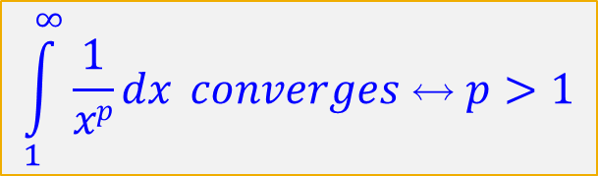

Determine whether each of the integrals is convergent or divergent.
$\int_{1}^{∞}{\frac{1}{x}dx}$
$\int_{1}^{∞}{\frac{1}{x2}dx}$
$\int_{1}^{∞}{\frac{1}{x+2017}dx}$
$\int_{1}^{∞}{\frac{1}{x2+2017}dx}$
$\int_{1}^{∞}{\frac{x+2017}{x2+2017}dx}$
$$\int_{1}^{∞}{\frac{1}{xp}dx} converges ↔ p>1$$

Slide 46
Chapter 8. sequence and series
Find the limit of the sequences:
Find the sum of the series: _{n=0}(1/2)^{n}, _{n=0}(2/3)^{n}
(by comparison test) Determine whether the series is convergent or divergent: _{n=1}(1/n), _{n=1}(1/n²), _{n=1}n/(n²+3), _{n=1}n/(n^{3/2}+5) , _{n=1}(1/n)
(by integral test) Determine whether the series is convergent or divergent: _{n=2}(1/nlnn), _{n=1}e^{-n}
(by alternating series test) Determine whether the series is convergent or divergent: _{n=1}(-1)^{n}/n, _{n=1}(-1)^{n}/n^{1/2}, estimate the sum with |error|<=0.001
Find the radius and interval of convergence of the power series: _{n=1}(2x-3)^{n}/n5^{n} , _{n=1}5^{n}/n! , _{n=1}(x-1)^{n}/3^{n}n²
Find the Maclaurin series, the Taylor series of functions: sinx, cosx, e^{x},…
Use series to find limits, integrals, …

Slide 47
A sequence {a_{n}} is defined by a₁=0, a_{n+1}=4/(a_{n}+3) for n>0. Assuming that {a_{n}} is convergent, find its limit.
A.-4
B. 1
C. 1 and -4
D. 0

Slide 48
Choose the correct statements.
A. If the series ∑a_{n} converges the lima_{n}=0.
B. If ∑a_{n} converges then lima_{n}0
C. If lima_{n}=0 then ∑a_{n} converges.
D. All of the others
a_{n} converges  lima_{n}=0
liman0  a_{n} diverges
lima_{n}=0 not imply a_{n} converges
a_{n} diverges not imply lima_{n}0

Slide 49
Which of the following series(es) is (are) divergent?
A.
B.
C.
D. All of the others
convergent if p>1 and
divergent if p≤1

Slide 50
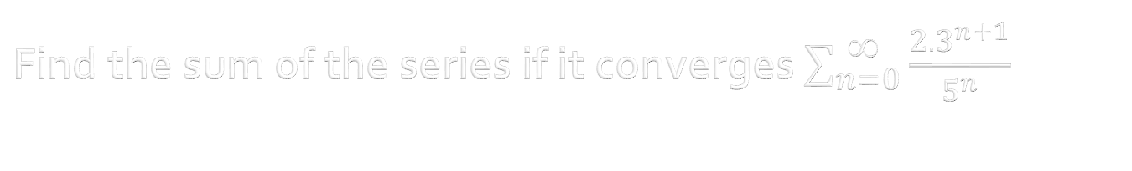
Find the sum of the series if it converges $\sum_{n=0}^{ ∞}{\frac{2{.3}^{n+1}}{5^{n}}}$
The series diverges
6/5
18/5
15
None of the others

Slide 51
By the root test, find the interval of convergence of the power series
A.[-3,1)
B. (-3,1)
C. (-3,1]
D. [-3,1]
Root test:
L>1 series diverges
L<1  series converges
L=1 : no conclusion

Slide 52
By the root test, find the radius of convergence of the power series
A. 8
B. 4
C. 2
D. 1/4

Slide 53
The 3-degree Tayor polynomial of g(x)=sinx at a=0 is…
A. T3=x-x³/6
B. T3=1+x+x²/2+x³/6
C. T3=1-x+x²/2-x³/6
D. None of the others

Slide 54
thanks

